Slide 1

Allergy-Safe Recipe Scanner
Group name: The Unnamed
Eric Middlekamp
Daeyong Jung
Hamoud Alhazmi
Wenyu Wang
Timebox 2 - June 13, 2024

Slide 2
Overview
Hamoud - Data Collection and cleaning
Jung - How Elasticsearch has been going
Eric - Application Update and next steps

Slide 3
1.
Data Collection and Cleaning

Slide 4
Burger Allergies
People can be allergic to various ingredients commonly found in burgers:
Bread (Buns)
  Wheat: A common allergen found in bread products
  Gluten: Present in wheat and other grains
Cheese
  Milk: A common allergen found in dairy products
  Lactose: Some individuals may be lactose intolerant rather than allergic

Slide 5
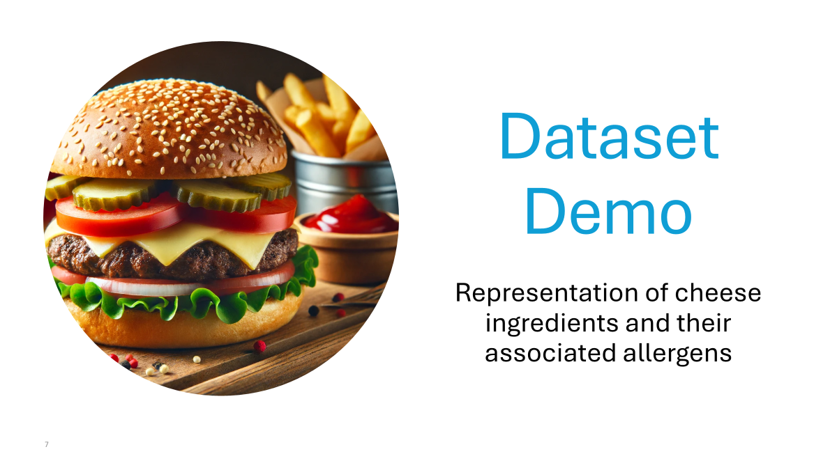
Allergy-Safe Recipe Scanner
Group name: The Unnamed
Eric Middlekamp
Daeyong Jung
Hamoud Alhazmi
Wenyu Wang
Timebox 2 - June 13, 2024

Slide 6
2.
Elasticsearch

Slide 7



Old Algorithm
Checking
Indexing
Recipes
Dataset
User Input
User Preference
Recipe
Output

Slide 8
Advanced Algorithm
Checking
Indexing
Dataset
User Input
User Preference
Recipe
Output

Slide 9
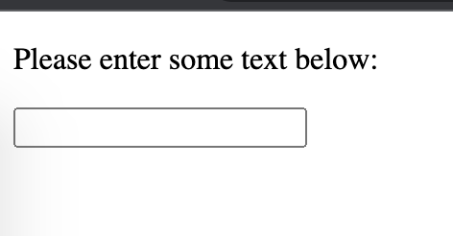
Problem: Scraping block
Method 1:
Text Input
Not User-friendly

Slide 10
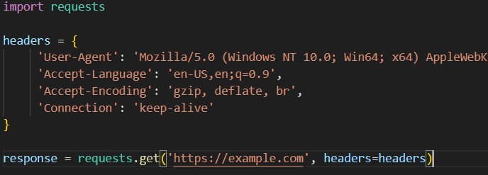
Problem: Scraping block
Method 2:
Requests with Headers

Slide 11


Problem: Scraping block
Method 3:
library supports JavaScript execution

Slide 12
3.
Updates and Next Steps

Slide 13
Implemented Required Features (MVP)
User Text Input
Can enter either a URL or text blob
User Management
Has to be a way to differentiate users
Technical Auth Context
Manage user access
Privatized Routes
Proper Routing
Routes between the pages of the application.
MongoDB Atlas
Database for user information

Slide 14
Challenges
Remembering Tailwind
Remembering HTML/CSS
Webpack compilation errors
Built backend in JS rather than Python
Sometimes it’s just your own fault…

Slide 15
Next Steps for Application
User Selection of Avoidances
Due to allergy
Due to preference
Save Past Searches
Text Blobs
Urls
Create Backend in Flask
ElasticSearch logic is in Python already
Handles user session
API for database
Make The Frontend Look Good
I’m not a UI designer
It looks… alright at best currently

Slide 16
Next Steps for Project
Verify ElasticSearch Integration
Works in the way we intend
Due to preference
Build out Data
Make sure it works with simple ingredients
Add more coverage
Integrate Components Together
Frontend, Backend, Data are separate
Backend -> Data first
Backend -> Frontend after

Slide 17
Thanks!
Any questions?

